Slide 1
Plan clustering
Introduction
Motivation:
Identify and summarise common plan patterns in our inputs
Activity-based analysis of scenarios
Needs-driven equity assessment
Questions:
How to define plan similarity / distance?
How to classify similar plans into distinct groups?
Do scenario results differ by cluster significantly?
impacts | demographic group <> impacts | plan group

Slide 2
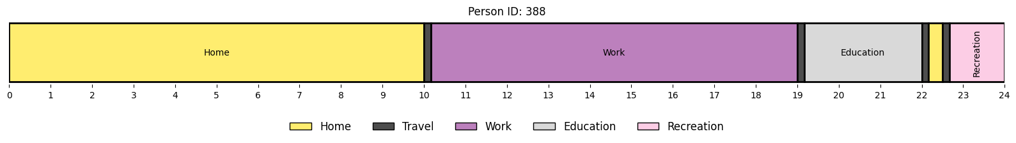

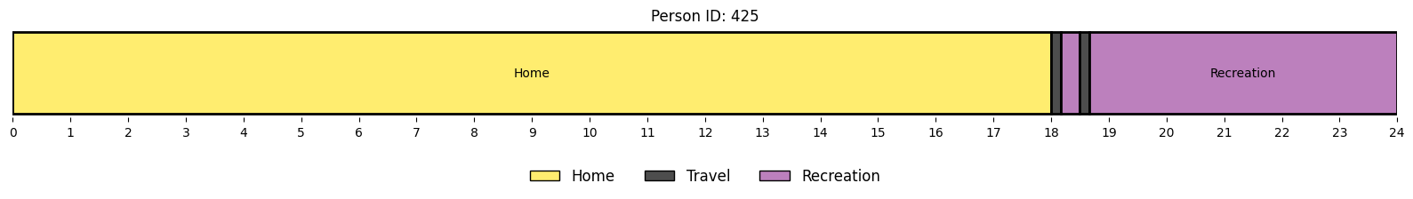
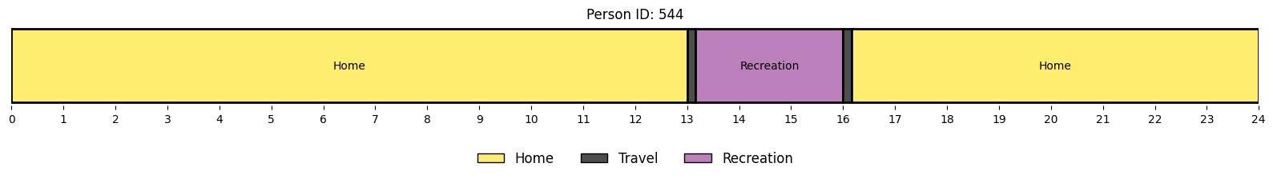
Plan clustering
Plan distance
Variable
Type of activities
Sequencing of activities
Duration
Travel duration
Distance metric
Edit distance: how many insertions / deletions / substitutions are required to match two strings

Slide 3
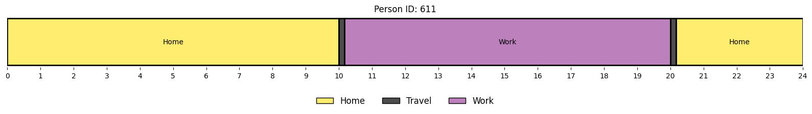

Plan clustering
Plan distance
PAM plan
Encode to string sequence
Calculate edit (Levenshtein) distance to all other plans
hhhhhhhhhhhhhtwwwwwwwwthhhhh

Slide 4
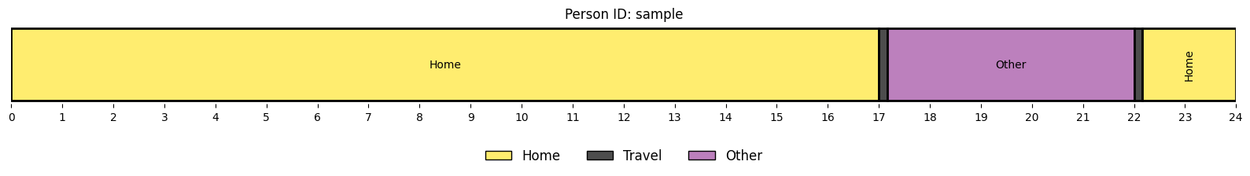
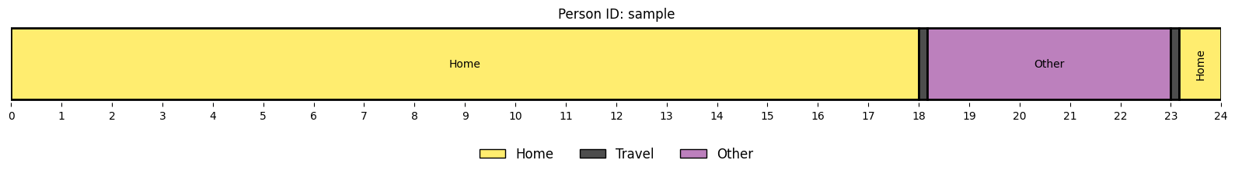
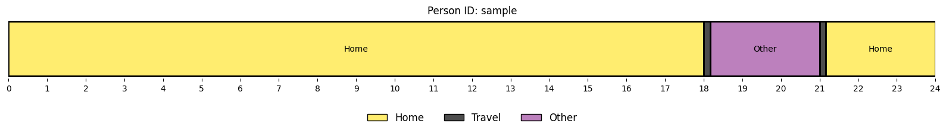
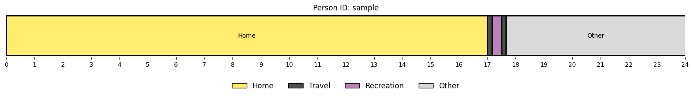
Plan clustering
Plan – Nearest neighbour
Find the “nearest neighbours” of a selected plan:
selected:
closest match:
2nd closest match:
3nd closest match:

Slide 5
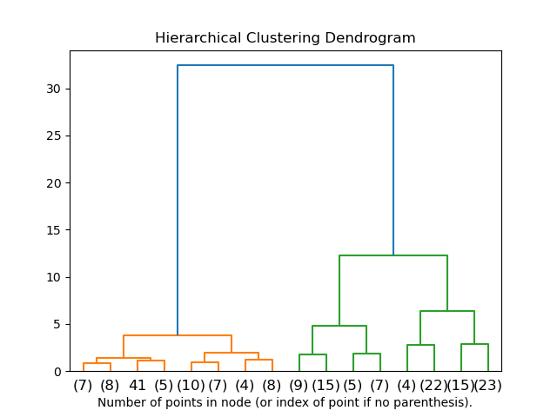
Plan clustering
Clustering
Approaches
Hierarchical clustering (ward distance)
Agglomerative clustering
DBSCAN
Use of custom distance metric (pre-computed Levenshtein matrix)
Choices
Clustering method
Number of clusters / distance threshold?
Cluster size distribution
Source: https://scikit-learn.org/stable/modules/generated/sklearn.cluster.AgglomerativeClustering.html

Slide 6
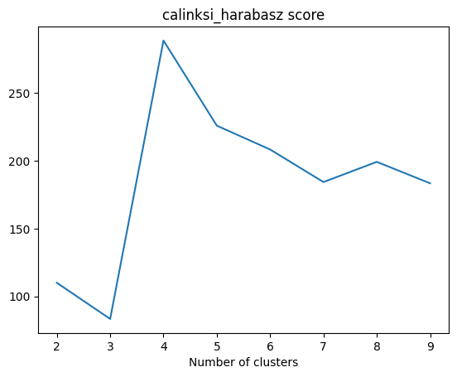
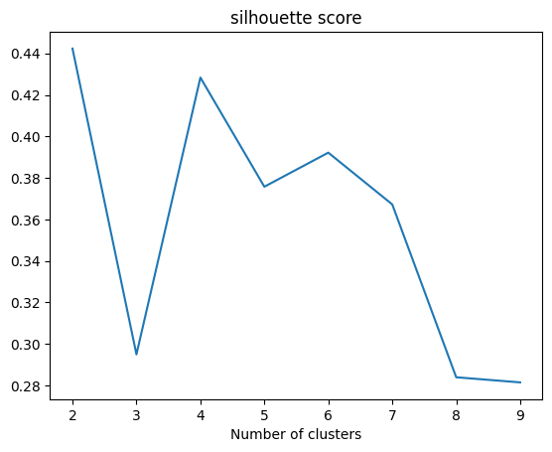
Plan clustering
Clustering – model configuration
Number of clusters selection
Cluster cohesion / separation
Calinski-Harabasz score
Silhouette score
Visualisation of cluster activity patterns
→ n ~ 4-8

Slide 7
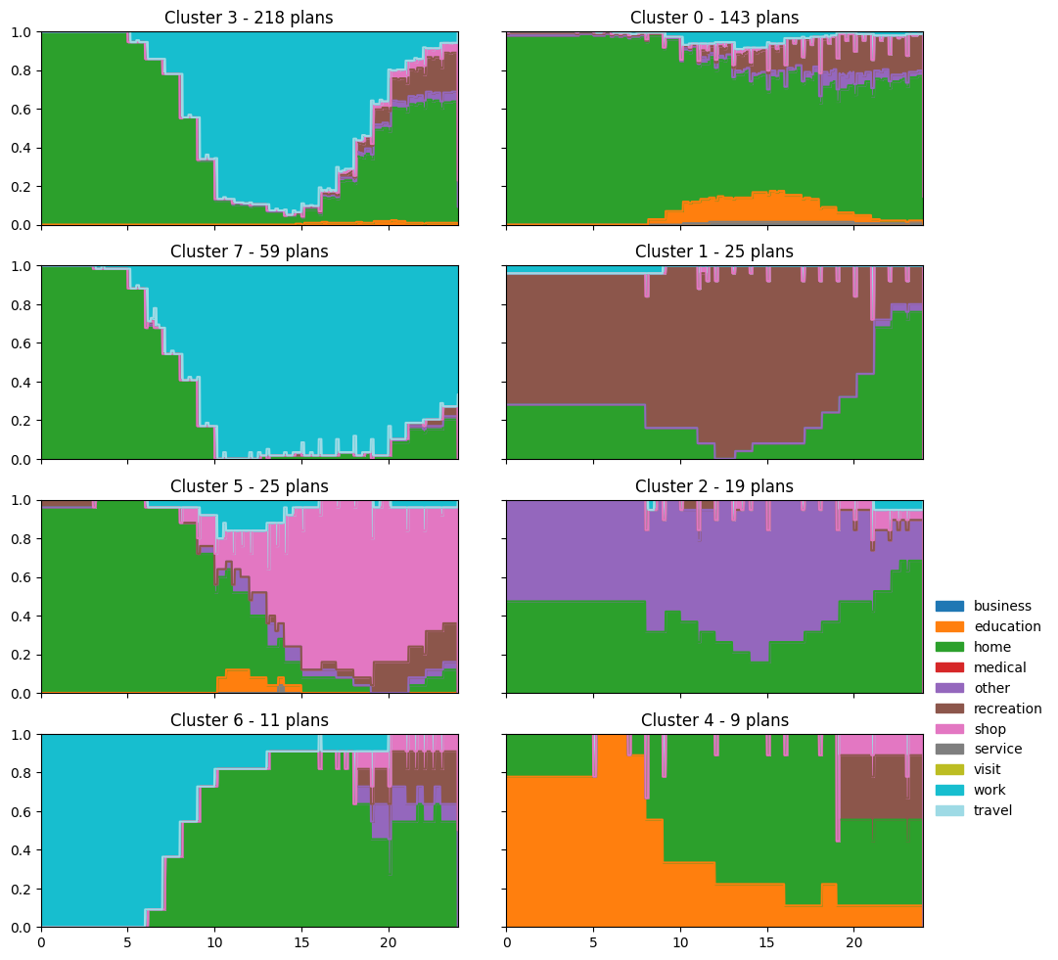
Plan clustering
Clustering - results
Preferred model
Agglomerative hierarchical clustering (sklearn)
8 clusters
Complete linkage
Levenshtein distances
distinct patterns: 9-17 workers (cluster 3), discretionary + students (0), long working hours (7), long recreation (1), afternoon/evening shopping (5), …

